Slide 1

Relational Design Critque
Louis Davidson – drsql.org

Slide 2
http://jssug.com

Slide 3

Slack Channel – https://jssug.slack.com
#jssug #sqlhelp #jobhelp #sqlsatjax
https://tinyurl.com/y6spgfwn

Slide 4
Please Take Pictures and Post!
#SQLSatJax
@JSSUG
And for this session @drsql

Slide 5

501 Legion Charitable Donation
Thank the 501 Legion for Supporting Our Event!
JSSUG Will Match Donations up to $200
Donation Bucket on Registration Table

Slide 6


Slide 7















Slide 8
Don’t forget Session Eval’s for Speakers!
Don’t forget Event Evals for xBox Raffle!
Schedule is Online and in GuideBook App

Slide 9
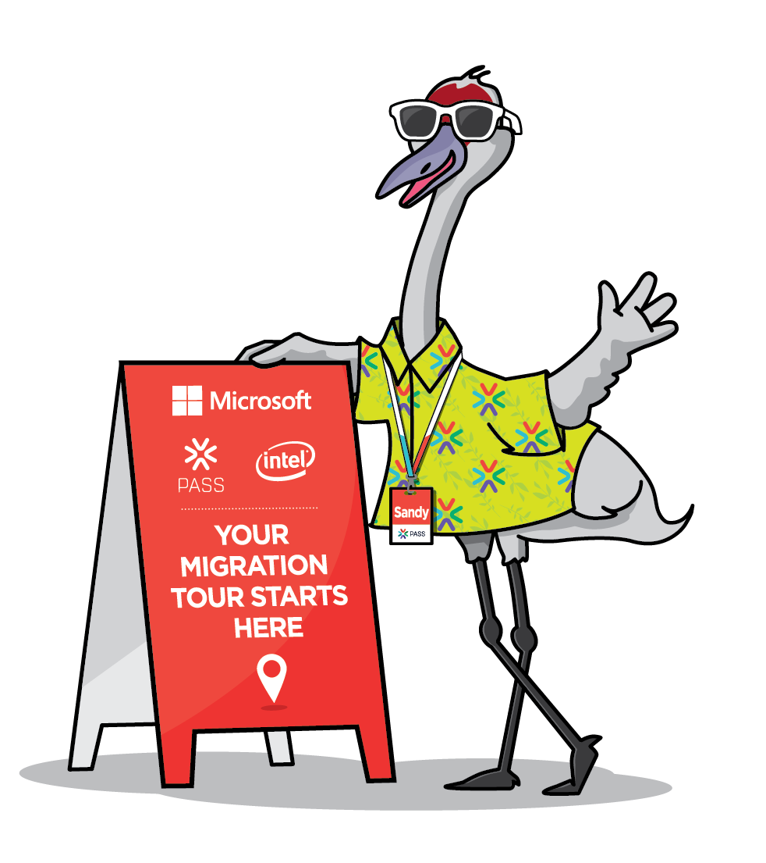
Modern Migration Tour
Register: https://tinyurl.com/y6qom9n3
When: June 15, 2019
Where: UNF
Sponsored by:
PASS, Microsoft & Intel
Notes:
In the lead up to SQL Server 2008 end of support, PASS has recruited Sandy—an expert in all things migration—along with an all-star lineup of speakers from Microsoft and Intel®, to smoothly guide you to your final destination—a modern data platform.
Whether you’re interested in moving to an updated on-premises, cloud, or hybrid solution; PASS, Microsoft, Intel®, and Sandy (of course!) have teamed up for a must attend series of webinars, in-person events, and migration resources, dedicated to giving you the tools you need to migrate with confidence.

Slide 10
And now….

Slide 11


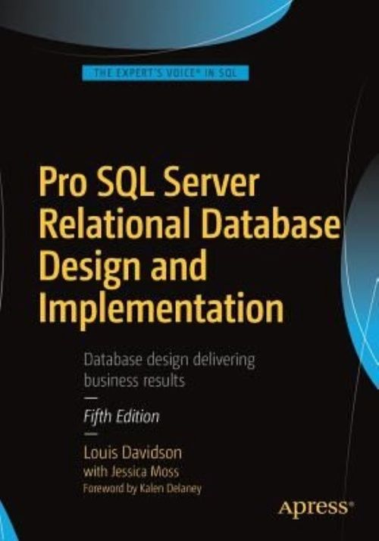
Who am I?
Been in IT for over 20 years
Microsoft SQL MVP For 14 Cycles
Corporate Data Architect
Written five books on
database design
  Ok, so they were all versions
  of the same book. They at
  least had slightly different titles each time
They cover some of the same material…in a bit more depth than I can manage today!

Slide 12

Warning: This session is very interactive
If no one participates, it will last about 15 minutes
If everyone participates, it should be a lot of fun
This Photo by Unknown Author is licensed under CC BY-SA-NC

Slide 13
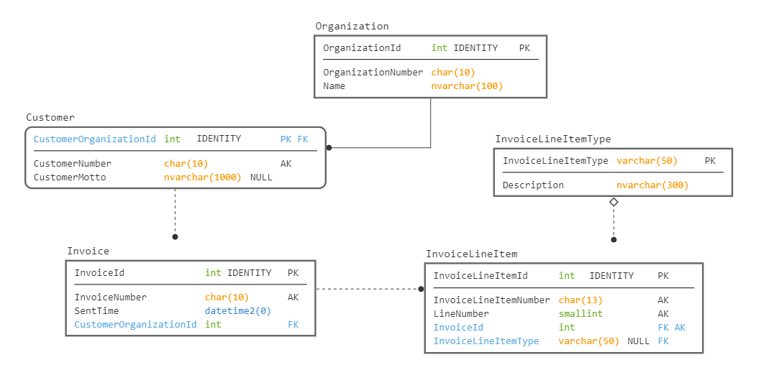
Data Model Graphical Language Basics
Primary Key
Solid Line Means FK is Identifying (Means PK of Parent in PK of Child)
Dashed line is non-identifying
AK is an UNIQUE CONSTRAINT.
Cannot tell from diagram if there are more than one AK
Columns NOT NULL unless specified.
Dot on end represents child table in relationship (Foreign Key is in Child table)
Diamond indicates this is an optional relationship (the FK value can be NULL)

Slide 14
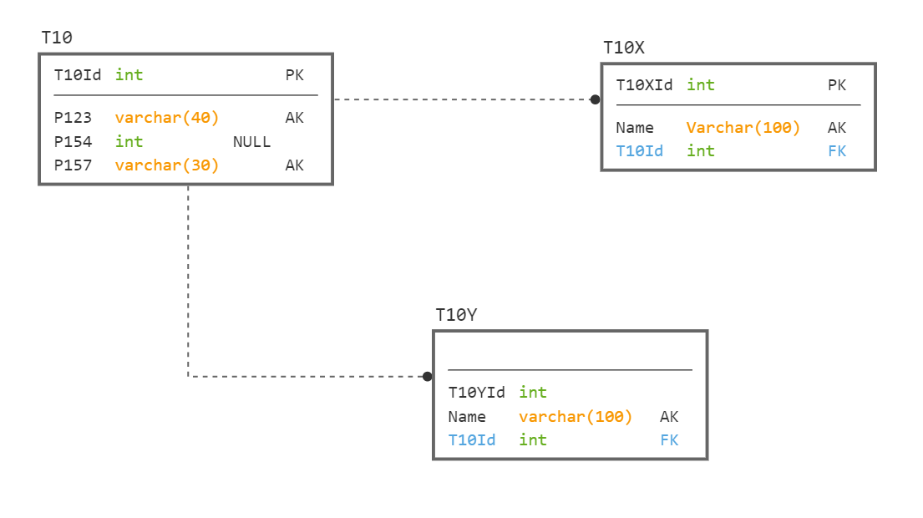
#1

Slide 15
Only one thing is for certain wrong…
Every Table Needs A Primary Key

Slide 16


Don’t Judge A Database Only By Its Model
Judge it by how its model compares to the requirements
Every data model could be for a real database
Companies do really weird stuff
Realistically though, this is USUALLY wrong
Note: last “trick” requirements question. In the future, model problems will be based on normal issues.

Slide 17
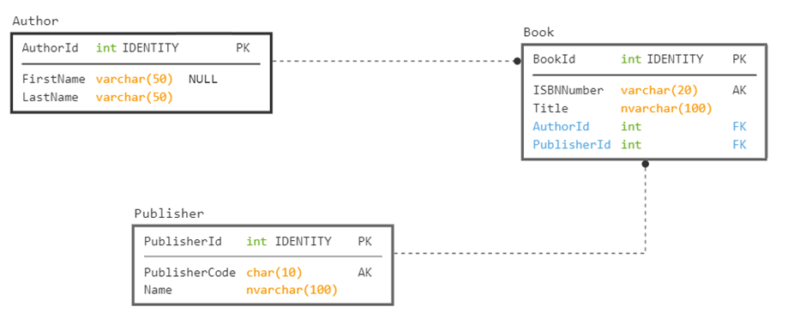
#2
Requirement: Store information about a books and authors

Slide 18
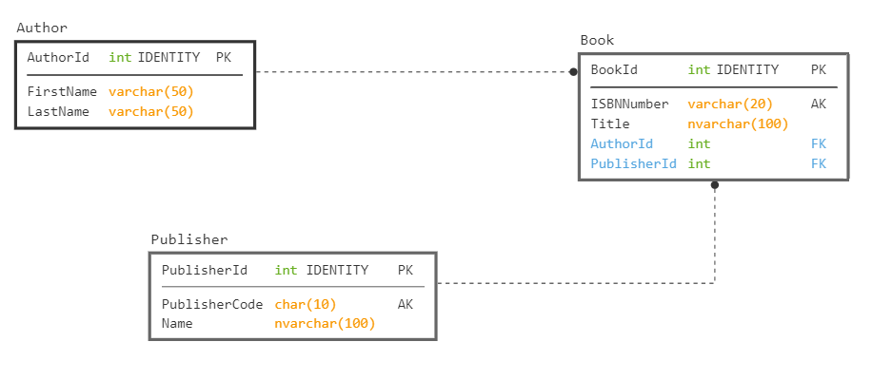
In 2017 and earlier: Use nvarchar
In 2019 on: Use nvarchar or varchar with UTF-8 Collation

Slide 19
Needs an alternate key, since the AuthorId is an identity value. What if we have three authors with same first and last name?

Slide 20
Books may have more than one Author.
Also, first name should likely be nullable

Slide 21
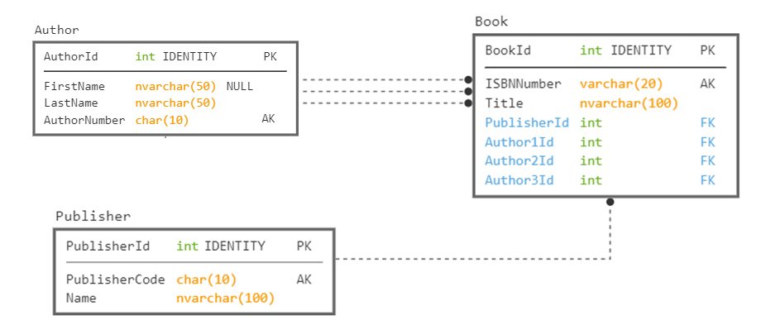
#2.1
Requirement: Store information about a book and the author

Slide 22
Books may have more than three Authors. (I worked on a book with 50)
This also makes a very rigid implementation.
Another issue… These are not nullable columns, so we must have 3 authors

Slide 23
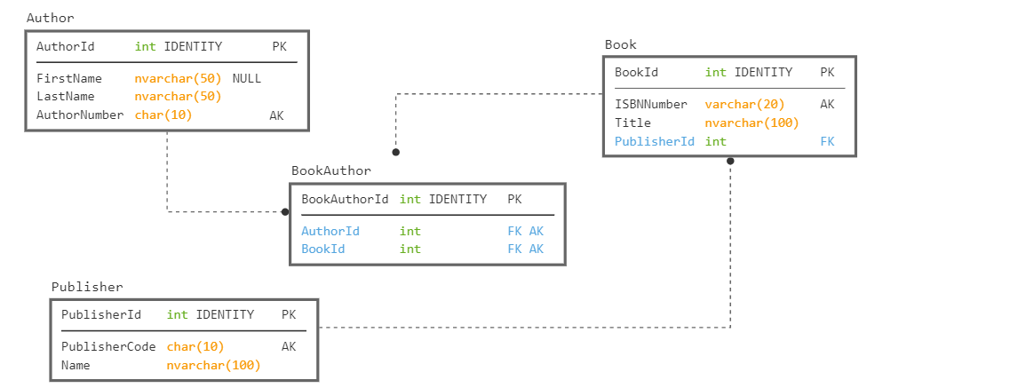

Slide 24
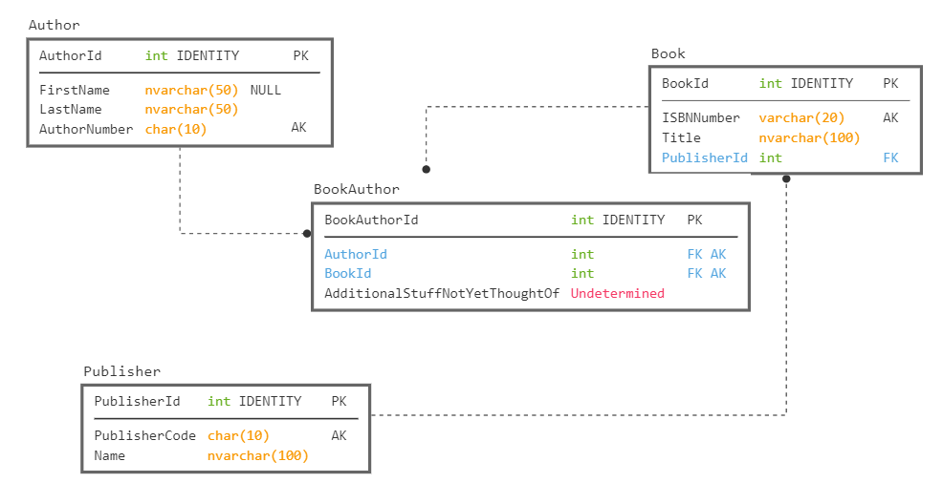
Lets us add details where they are needed too

Slide 25

Attribute Cardinality
When building your databases, make sure to consider the cardinality of each attribute
  Will the user need to store more than one value?
  Work to make sure that the design won’t bend past the limits you expect
Test with the most wild examples possible
  What about a book with 100 authors?
  Establish a “this is the max cardinality” rule if necessary
It is easier to deal with these problems at design time than once you have 3.5 million rows in your book table.

Slide 26
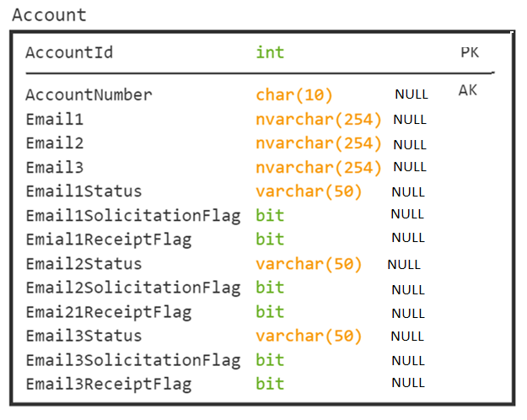
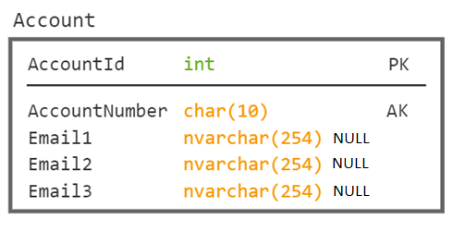
Real, But Sad Example
Louis doesn’t spell very well. But this is critique fodder!
(The poor spelling is not from a real DB!)
Bonus Point Time:
Any other problems you see?

Slide 27
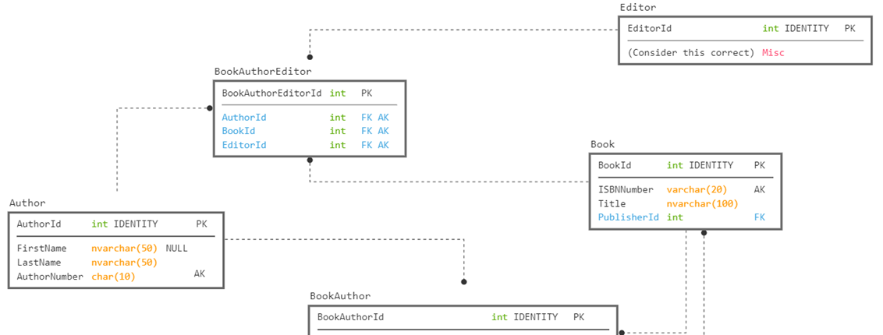
#3
Requirements: Define the authors and editors of a book

Slide 28
Book, editor, author
Note: consider the values keys to other tables
Table IS in definitely 3NF, since it only has key attributes
Table is in not in 4NF if this represents:
  Book “Design” has authors Louis and Jeff and Editor Tony
  Book “Golf” has authors Louis and Fred and Editors Steve and Tony
Table is in 5NF if this represents
  For book “Design”, Editor Tony edits Louis’ work and Leroy edits Jeff’s work
  For book “Golf”, Editor Steve edits Louis’ work, and Tony edits Fred’s work.
Book Author Editor
=================== =================== ===============
Design Louis Tony
Design Jeff Leroy
Golf Louis Steve
Golf Fred Tony

Slide 29

Document Complex Keys
When you have > 2 independent attributes in a key, consider the actual meaning
Make sure that all of the non-key columns actually refer to the entire key
If all attributes are not dependent on each other, then you may have issues

Slide 30
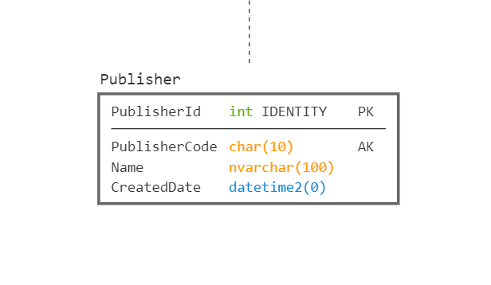
#4
Requirement: Determine When A Publisher Started Working With Your Company
ALTER TABLE Publisher
ADD CreatedDate datetime2(0)
DEFAULT (SYSDATETIME());

Slide 31

Rarely Rely on Defaulted System Values
The time when a row is created is rarely the time you care about
Anytime a customer really cares about a time value to seconds, or partial seconds, the time it takes to save the data matters
Real-ish example:
  User watches TV program
  Calls in take 30 seconds to dial, 22 to get an answer
  Then talks to a person on the phone for 10 minutes
  Decides to make a purchase
  It takes 2.1 minutes to take the order and then 10.4 minutes to work through the verification system
  The order is created over 22 minutes after they watched the program
  Which point in time matters? Which time can you actually capture?

Slide 32
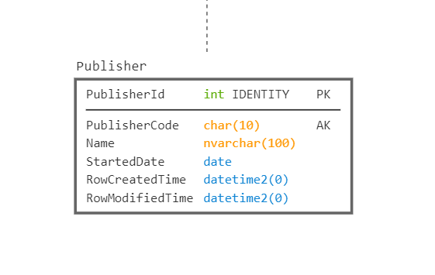
No default, make the user pick the time (defaulting the value in the UI to the current time DOES make sense, but data could go through layers of objects/async processes to get to the database)
Tells you when the row itself was added to the database
Consider using TimeZone Offset Aware Datatype if you have any likelihood of having servers in multiple time zones (we have all time in Eastern Time)
Use the datatype with the most realistic granularity.
You don’t want to say the Publisher started at ‘10:00:32.1213423’ unless it is actually important

Slide 33
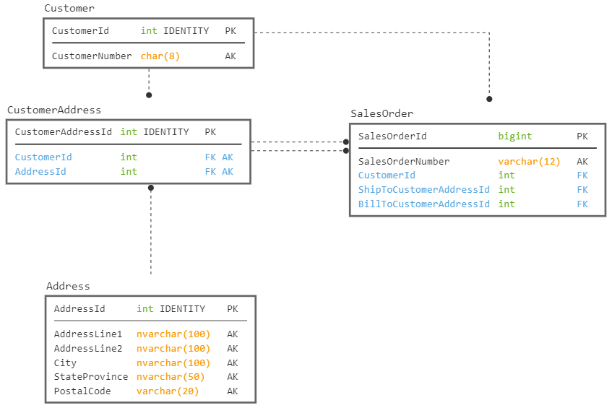
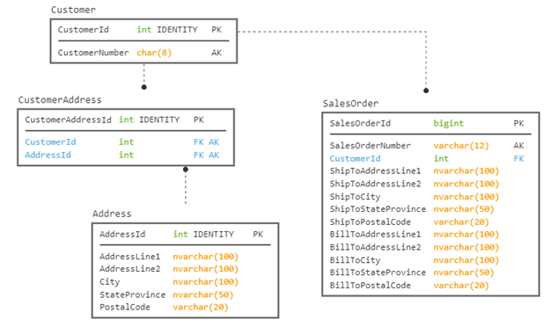
#5
Requirement: Capture the address of a customer for an order.
← This or This →

Slide 34
Do each of these have the same meaning?
#5
Requirement: Capture the address of a customer for an order.
← This or This →

Slide 35
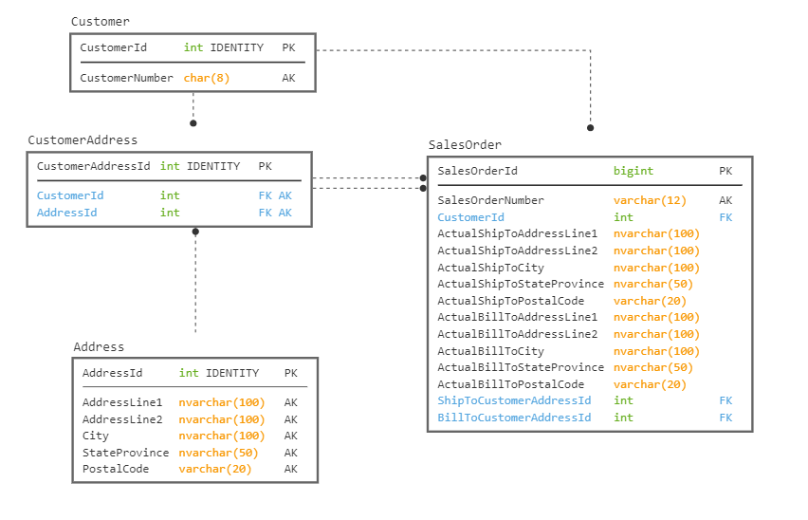
I lied. Another “trick” questions.
Answer: “It depends…perhaps both”
Maybe adding type would allow us to not have the key values on the address?
Copied version corresponds to “as of shipping” address. Never changes.
Should actual ship to columns allow NULL values
(Or be in its own table?)
Key version corresponds to “current” address. Meaning changes as customer changes their address

Slide 36
Practice reading databases
Database structures read like books
The better the database, the easier to follow the story
Subtle differences come from differences large and small

Slide 37
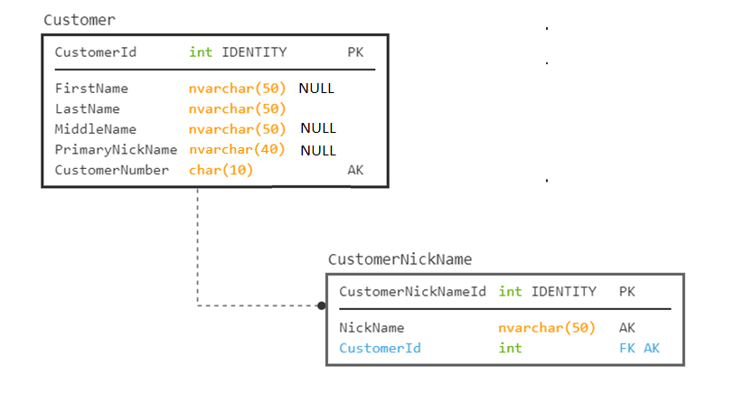
#6
Requirement: Need to store a customer and their nicknames. 99.9999% of our customers have only 1 nickname.

Slide 38
#6
Requirement: Need to store a customer and their nicknames. 99.9999% of our customers have only 1 nickname.
Now… Search for a customer with the NickName of ‘Fred’
You have to query two tables
Lets us add details where they are needed too
Another Common Issue:
Different datatypes on columns that hold the same thing

Slide 39
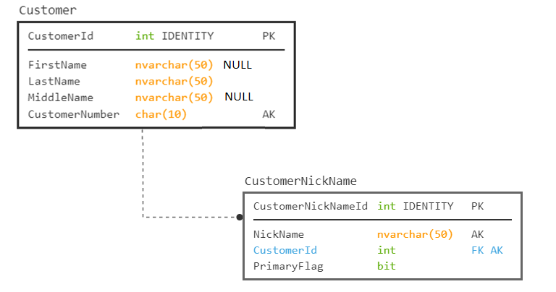
Now… Search for a customer with the NickName of ‘Fred’
You have to query just one table

Slide 40
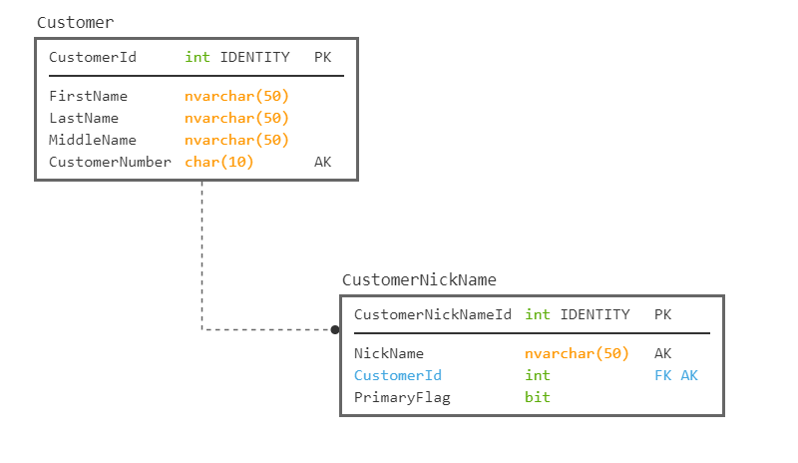
#6.1
Requirement: Build a UI to work with NickNames. Would this work?
First Name Last Name
Louis
Davidson
NickNames
Lewis; Dr SQL; Dr Squirrel; Louman; SQL Guy; Hey You!
As long as:
  the UI takes the normalized data and displays it in this manner,
  Saves it back to the DB correctly when saved
  Why not?

Slide 41
Database Designs must cater to the 100% case
Otherwise, you end up with the atypical data not being able to be stored.
For this nickname case:
  Tailor the UI to the user’s needs, put one nickname on the UI or an indicator that they have more than one
  Or make it clear that the first in the text list is primary
  The database should have the extra table for the nickname
When you search for a value, it should be able to be done in a single query without parsing data

Slide 42
This is what we are trying to avoid…
Dear Lewis; Dr SQL; Dr Squirrel; Louman; SQL Guy; Hey You!
We hope this letter finds you well, I hope that you, Lewis; Dr SQL; Dr Squirrel; Louman; SQL Guy; Hey You! will be able to attend our conference.
Sincerely,
Clearly Not A Person Who Pays Attention

Slide 43
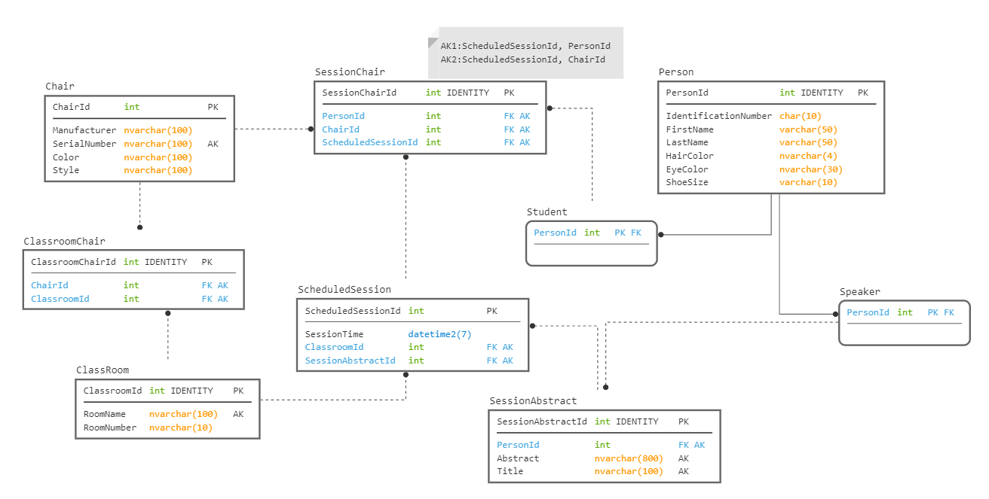
#7
Requirement: Model the classroom we are in

Slide 44
Well Designed, Normalized Design Should Match Requirements
Academically, it feels like you should break down every value into constituent parts.
Yet, if the customer doesn’t care, won’t use the details, it is not a good design
Your job is to meet the customer’s requirements and cover their typical usage of data

Slide 45
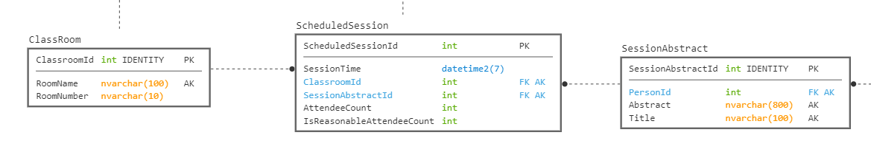
#8
Requirement: Capture the count of people in a session

Slide 46
Naming Standards Make A Big Difference
Avoid overly specific prefixes/suffixes
Follow a standard format for names
An example that I have seen documented in various places (often attributed to ISO 11179) is to have names that include something along the following:
  RoleName – Optional for when you need to explain the purpose of the attribute
  Attribute – The primary purpose of the column being named. Optionally can be omitted, meaning it refers to the entity
  Classword – a suffix that identifies the usage of the column, in non-implementation specific terms
  Scale – Optional to tell the user what the scale of the data is, like minutes, seconds, dollars, euros, etc
  RoleName_Attribute_Classword_Scale

Slide 47
Column Naming Examples
Name - a textual string that names the row value, but whether or not it is a varchar(30) or nvarchar(128) is immaterial (prefix is implied. Example Company.Name)
UserName - a more specific use of the name classword that indicates it isn’t a generic usage
AdminstratorUserName – A user name, but specifically for the admin user.
PledgeAmount - an amount of money (using a numeric(12,2), or money, or any sort of types)
PledgeAmountEuros - an amount of money (using a numeric(12,2), or money, or any sort of types), but with an atypical scale
TickerCode - a short textual string used to identify a ticker row
EndDate - the date when something ends. Does not include a time part
SaveTime - is the point in time when the row was saved
MailIsHereFlag – indicates that the mail is here. Could be a bit, ‘yes’ or ‘no’, and could be null, because we aren’t sure if the mail is here or not.

Slide 48
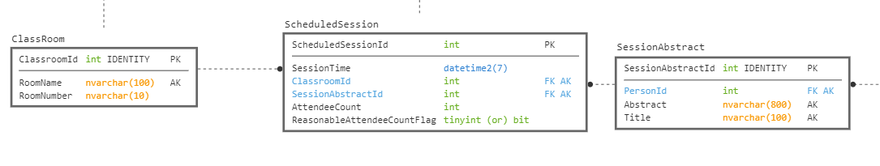

Slide 49
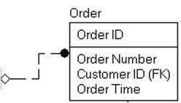
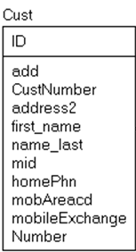
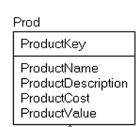
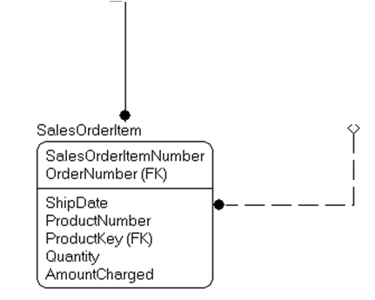
The best of intentions
One Naming Standard: Even if it stinks

Slide 50
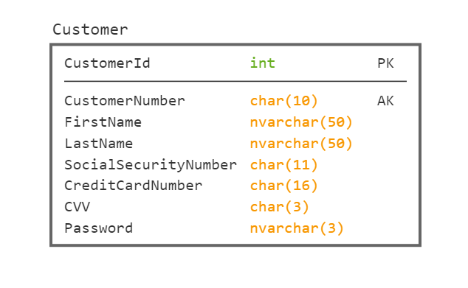
#9
Requirement: Capture Personally Identifiable Data About A Customer

Slide 51
Oh so many things wrong
First:
  Only store Personally Identifiable data when you must
  For credit card numbers, try to use a bank that will keep the data safe and give you a token that only you can reference
Second:
  Anything you must store: encrypt
  Make sure the encryption is strong
  Make sure the key to decrypt isn’t available too easily
And a 3 character password limit is horrible enough even if you encrypted it

Slide 52
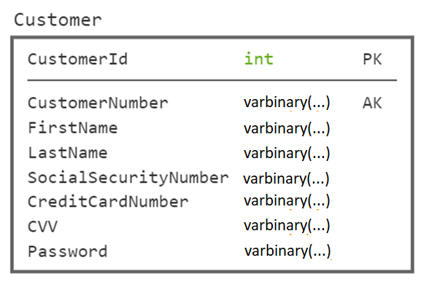
#9
Requirement: Capture Personally Identifiable Data About A Customer
Should these allow NULL values?

Slide 53
#10
Question: What is this?
CREATE TABLE Blob
(
BlobValue nvarchar(max),
MakeUniqueValue int NOT NULL
UNIQUE DEFAULT (1),
CHECK (MakeUniqueValue = 1)
);
Answer: The most ______________ database possible
denormalized

Slide 54
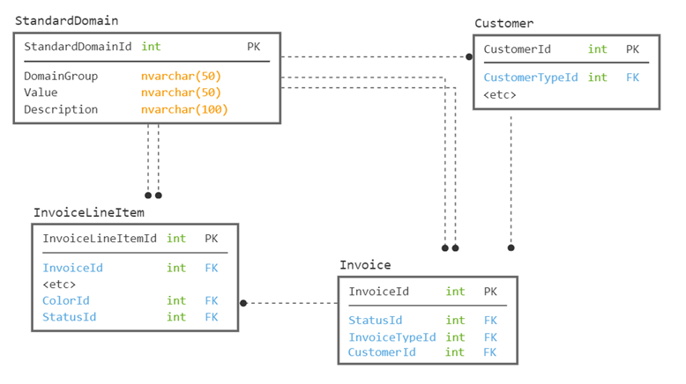
#11
Requirement: Store domain data about one or more tables

Slide 55
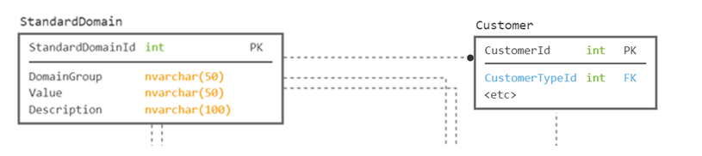
Generic Structures
(not a favorite)
Consider this snippet.
You would need groups and values for different usages:
  DomainGroup=CustomerType; Value=Individual; Description=Etc
  DomainGroup=CustomerType; Value=Organization; Description=Etc
Now… How do you validate that Customer.CustomerId has only CustomerType values, since you will also have Color, InvoiceStatus, etc

Slide 56
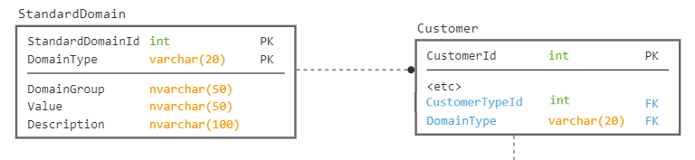
Generic Structures
(not a favorite)
Now… How do you validate that Customer.CustomerId has only CustomerType values, since you will also have Color, InvoiceStatus, etc
A variant would make the type a part of the key, and hence FK
  Then you can validate with a check constraint…
  Still… Uck

Slide 57
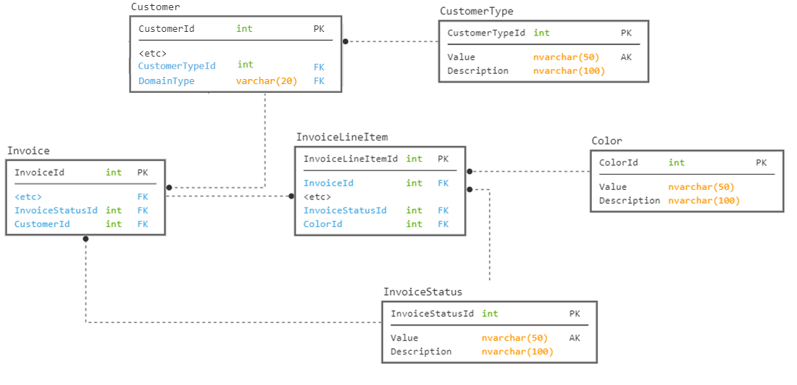

Slide 58
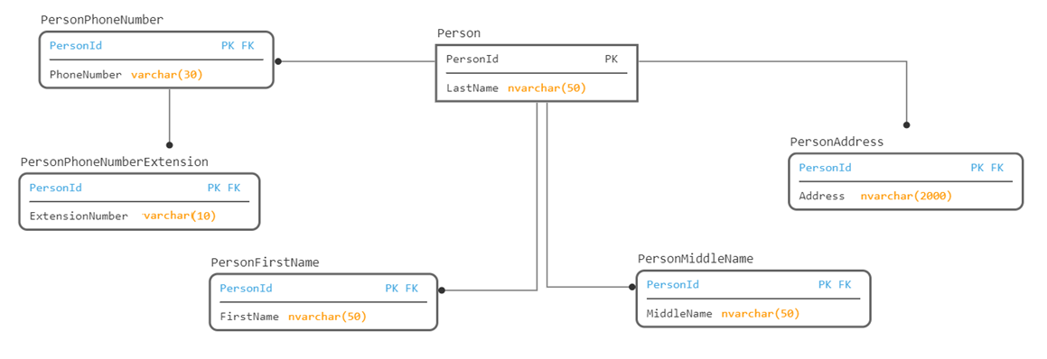
#12
Requirement: Store information about a person, efficiently

Slide 59
Avoiding NULL values is a good goal… but
Don’t do it by making your design bizzaroland complicated
  To use the data, you would just have to do outer joins, and missing data would be ….. NULL
Note: this was taken from a friend of mine’s actual experiences

Slide 60
What about very structured values
  Example: phone numbers, address, credit card number, social security number
  Should only be broken down to the way the user will use it
  Just a blob of text may be adequate for your usage if:
    You rarely search by area code, or exchange (particularly to update an area code)
    You need to store many country’s phone number format (breaking the table into 1 table per format would make it very unusable)

Slide 61
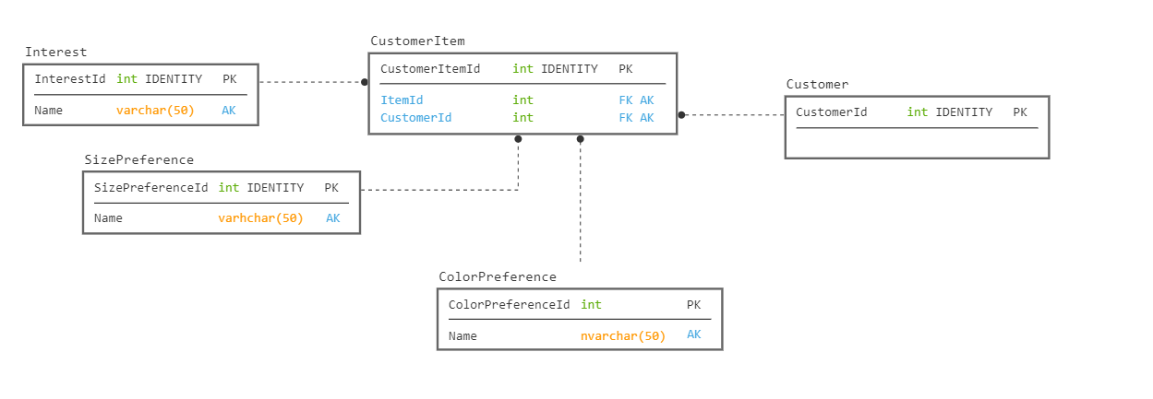
#13
Requirement: Store various multi-valued attributes about a customer.

Slide 62
This is a Simulated Graph Structure
SQL Server 2017 and later have Graph objects (Node and Edge) as first class tables.
The model will look very similar, but internally they are managing the relationships
Special syntax is available for working with graphs
Building like this will make you crazy
  It is hard to tell where the relationship comes from without more data
  Make a table per many-to-many relationship with a table if building relationally
  You still have to join each table individually

Slide 63

Questions? Contact info.. Thank you!
Louis Davidson - louis@drsql.org
Website – http://drsql.org ← Get slides here
Twitter – http://twitter.com/drsql
Blog on Simple-Talk
https://www.red-gate.com/simple-talk/author/louis-davidson/
Notes:
[twitter] Slides will be on drsql.org in the presentations area for this and the keynote as soon as I can get them out there. @rmtechtrifecta [/twitter]

